Slide 1
Data analysis and field study on Toronto restaurant
By Henrique Pan

Slide 2
Benefits of this study
By analysing the neighbourhoods one can identify
The number of restaurants in the vicinity
The number of restaurants offering similar cuisines in the vicinity
The distance from the city centre.
It gives an brief overview of the neighbourhood and competition for the business
This becomes a good starting point for the individual to start his search for a good location

Slide 3
Data Acquisition and Cleaning
Get the details of the city center and neighbouring boroughs
Identifying the restaurants in these areas
Finding out the categories of restaurants
Identifying the areas with less restaurant density, specially Chinese Restaurant

Slide 4
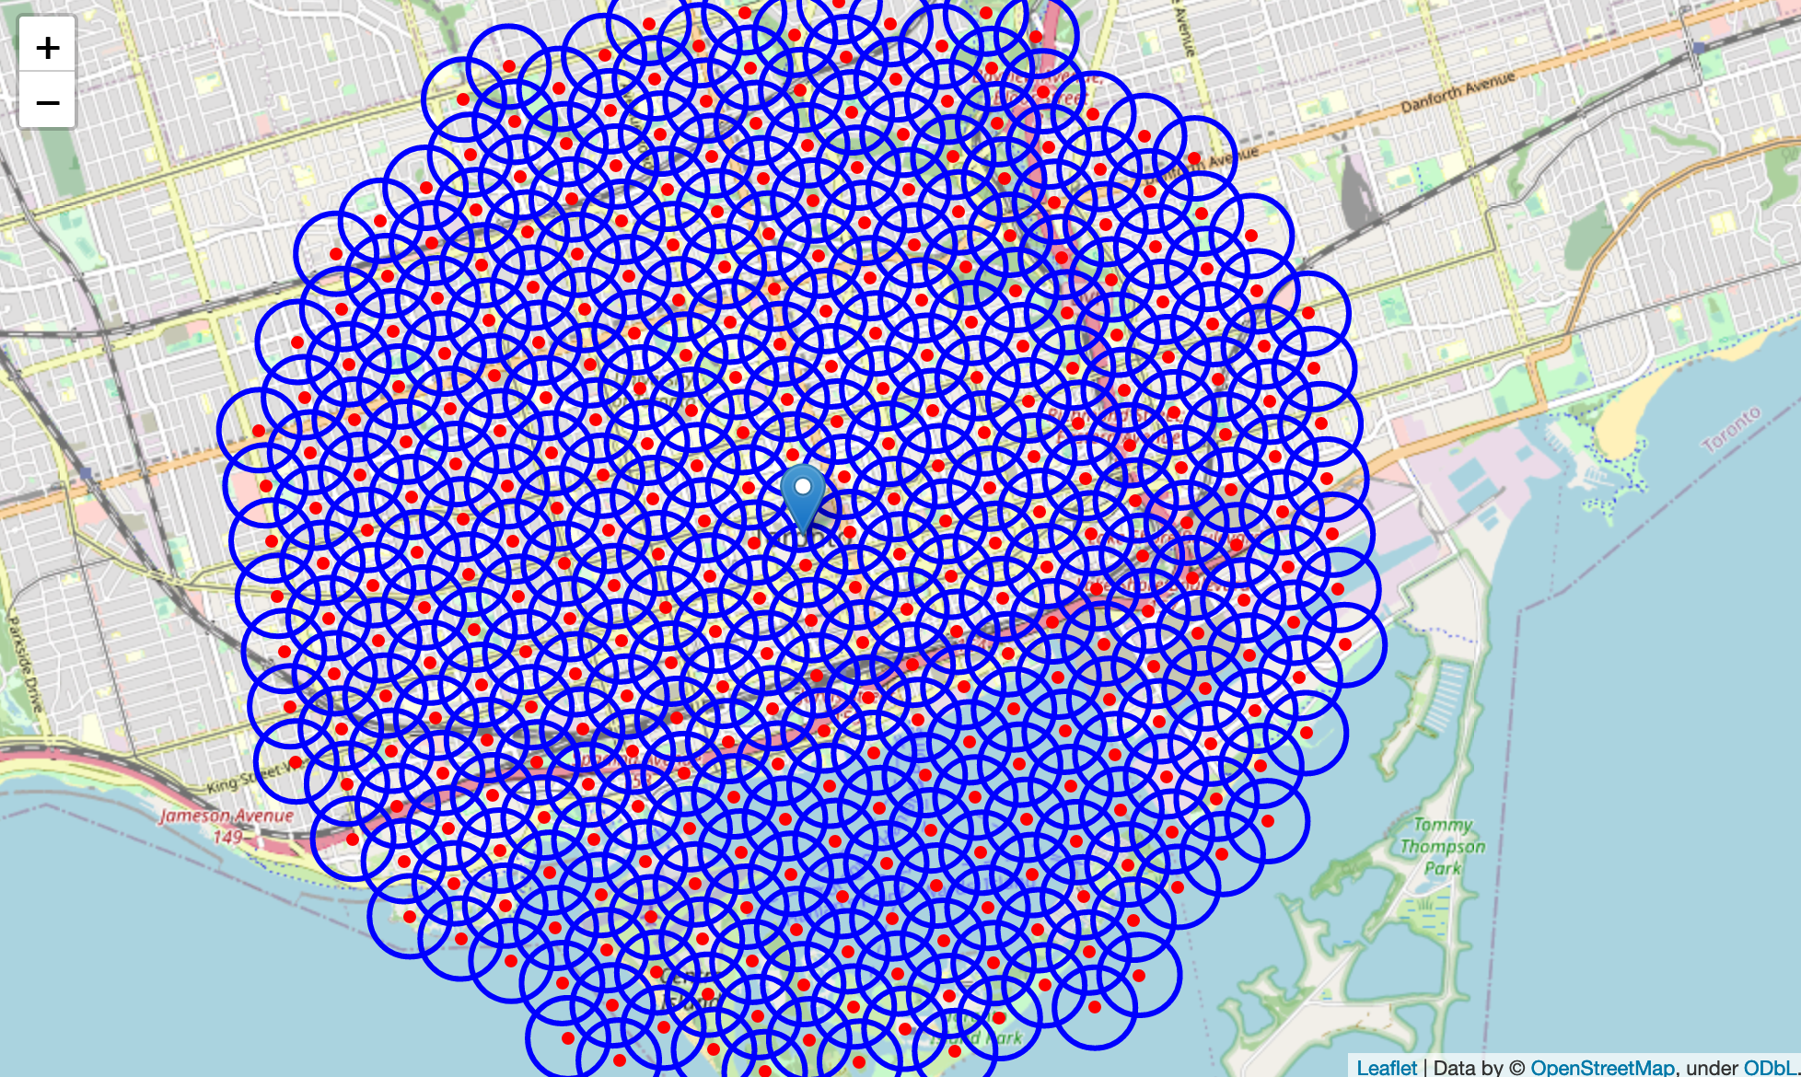
Gridding the area

Slide 5
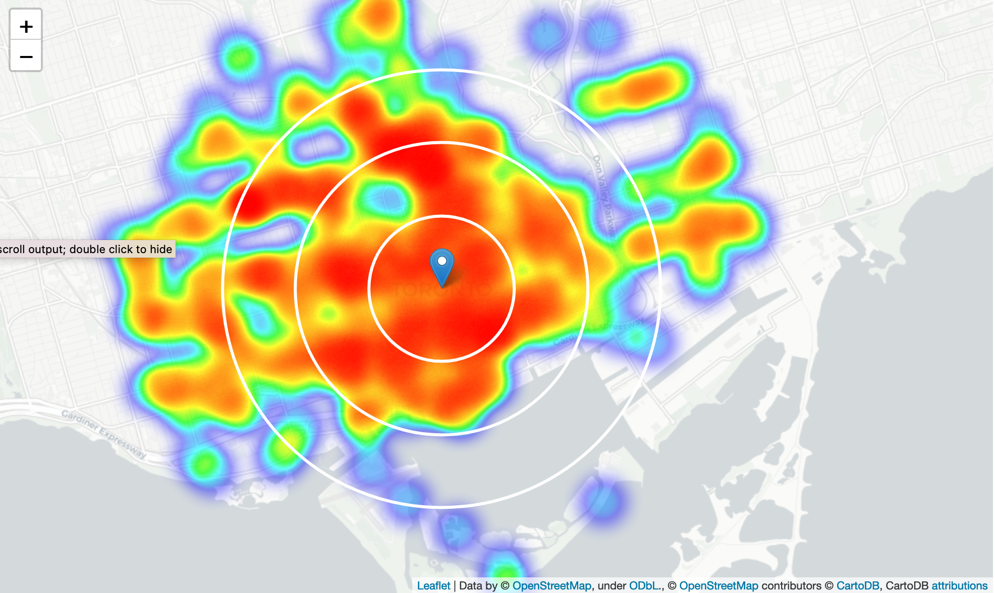
Finding restaurant density

Slide 6
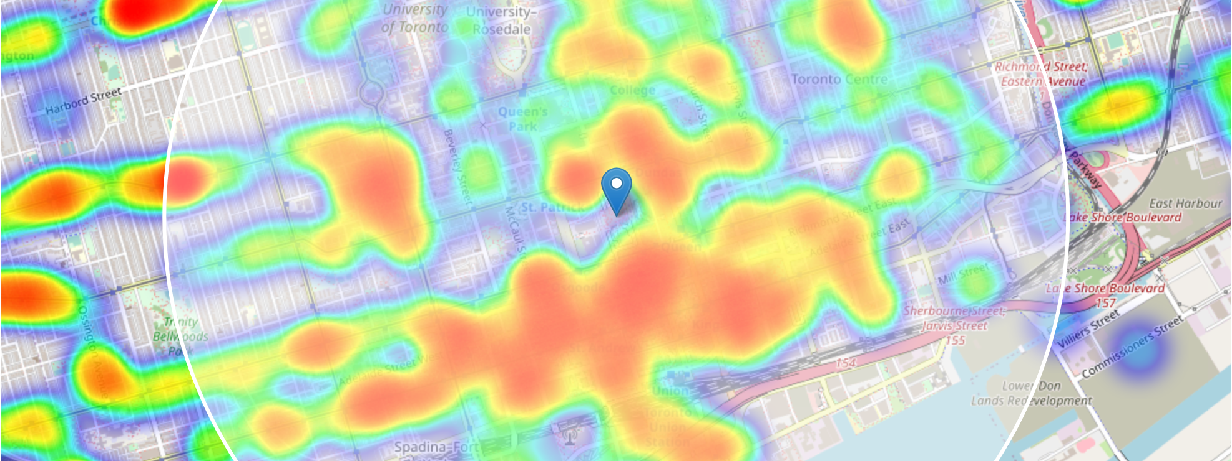
Narrowing target area

Slide 7
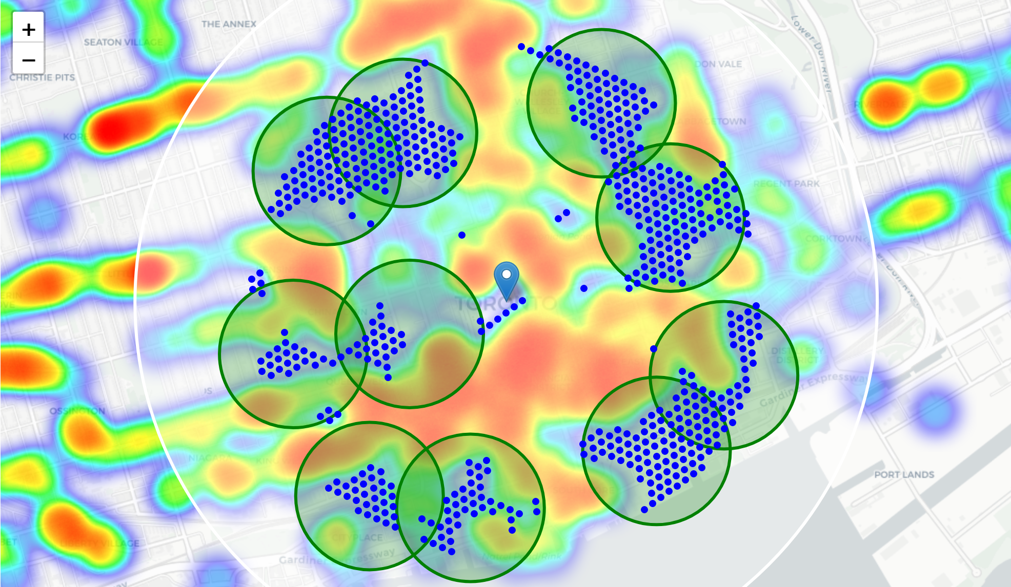
Clustering zones that fits the criteria

Slide 8
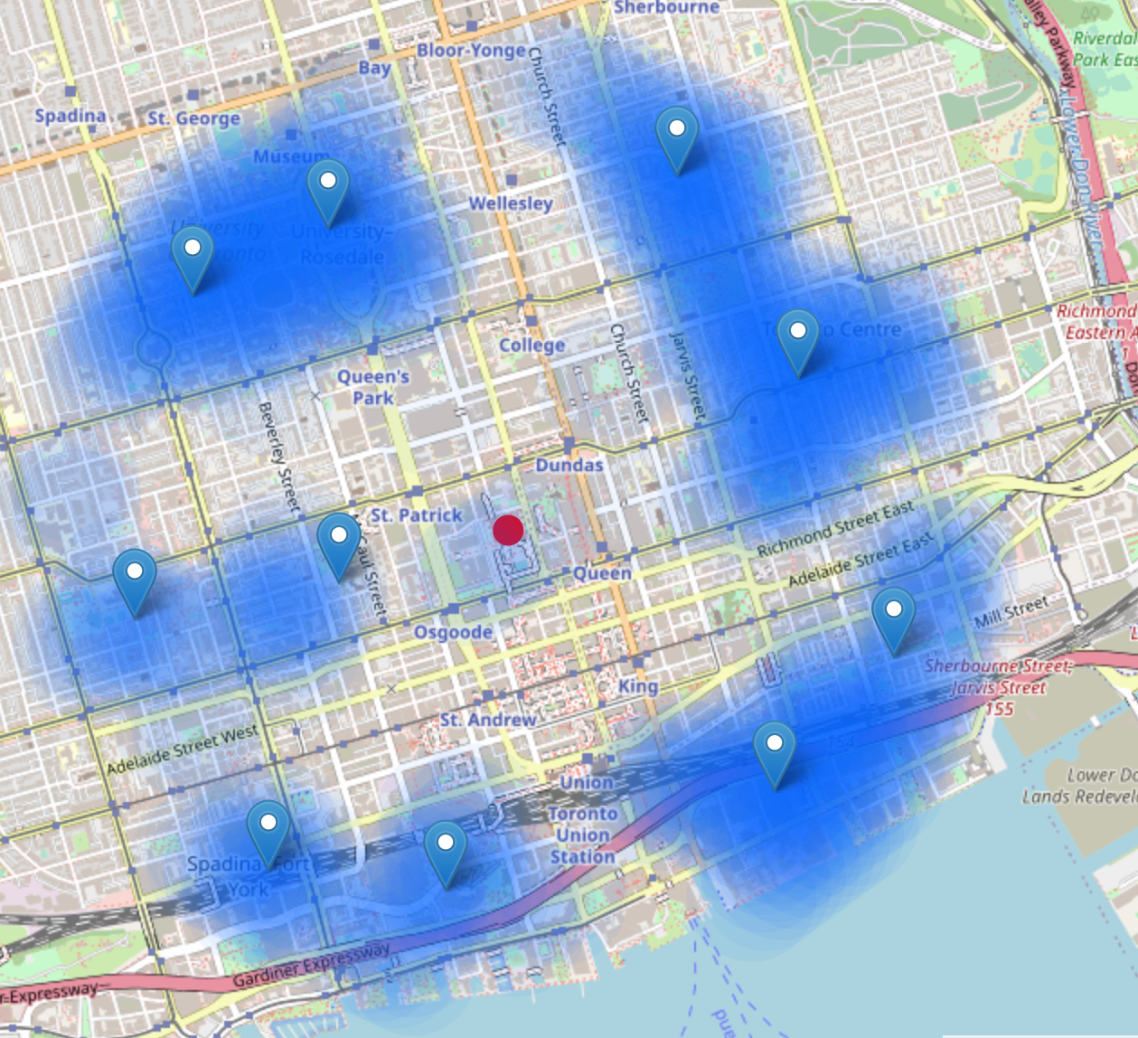
Pinpointing the target area

Slide 9
Conclusion
By finding all restaurants we can cross this data with its geographics
Crossing data between restaurants we can find spaces around the city that have potential to receive a new restaurant
In this example we used Chinese Cuisine, but it can support any kind of Restaurant
With further work it can provide assist to any new business, not only restaurant

